Slide 1
Evaluating deep learning models for electricity price forecasting
Mia Zdybek

Slide 2

About me
Mia Zdybek
Svea Solar
KTH
Planning/admin
App support
Developer intern
Bachelor of Engineering – Engineering Physics
Master of Engineering –Machine Learning

Slide 3
Agenda
Introduction to the problem of the thesis
Introduction to machine learning
Method
Results
Conclusions

Slide 4
1. Introduction to the problem

Slide 5


Motivation
Benefits of spot price prediction
Improved strategies for purchasing and selling electricity (financial gain)
Plan production and consumption so that losses are minimized, and grid balance is kept (sustainability)

Slide 6
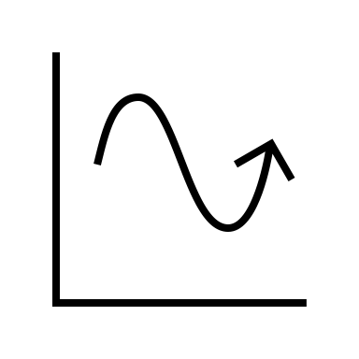
Objective
Find a relatively simple machine learning model that can predict spot prices 10-days ahead with good accuracy

Slide 7

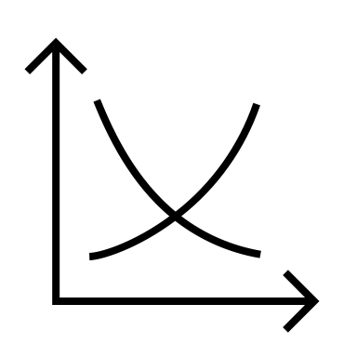

Problem
Electricity spot prices are unstable
Electricity spot prices depend on electricity demand and supply (and bidding strategies)
Demand and supply depend on unstable parameters:
- Weather
- Seasonal societal/behavior (holidays, weekly/monthly behavior)
- Politics
- Power source
- Transfer bottlenecks

Slide 8
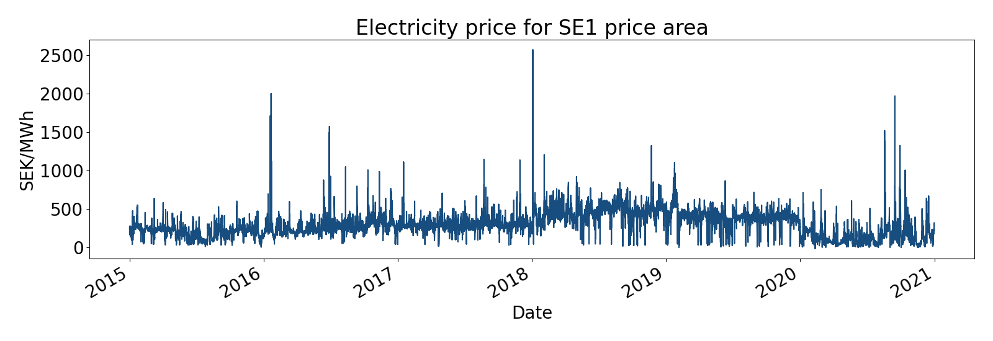
Spot prices
Erratic
Can change drastically from hour to hour

Slide 9
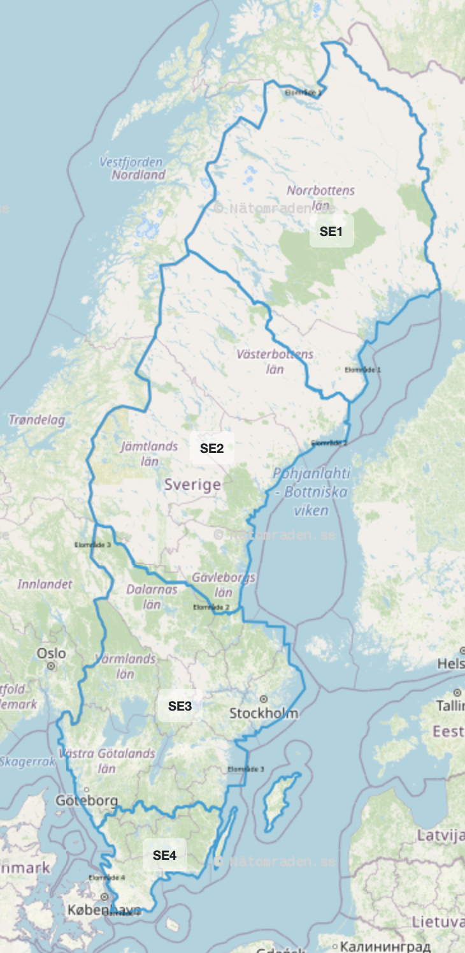
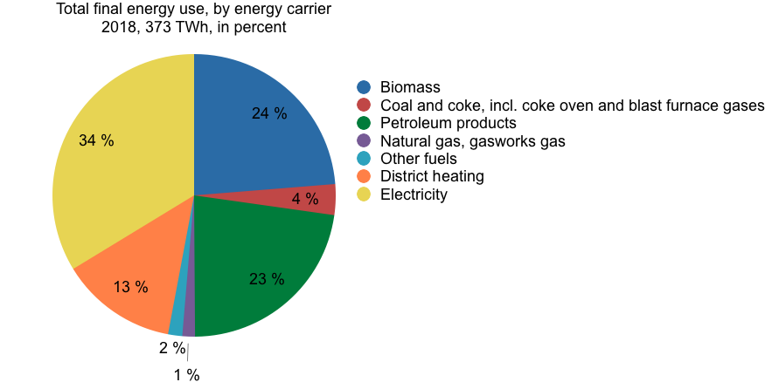
Electricity in Sweden
34 % of energy use was in electricity form in 2018
Mostly from hydropower and nuclear power
Renewable energy sources are increasing
Four price areas
Production/consumption deviation between north and south

Slide 10
2. Machine learning

Slide 11
What is machine learning?
AI - Any device that perceives its environment and takes actions that maximize its chance of successfully achieving its goals.
Artificial Intelligence
Machine Learning
ML - Algorithms based on mathematical models, that enable the AI to learn over time and improve its performance when given more input.
Deep Learning
Deep learning - Advanced ML algorithms with more parameters, deeper networks and more complex dependencies.

Slide 12


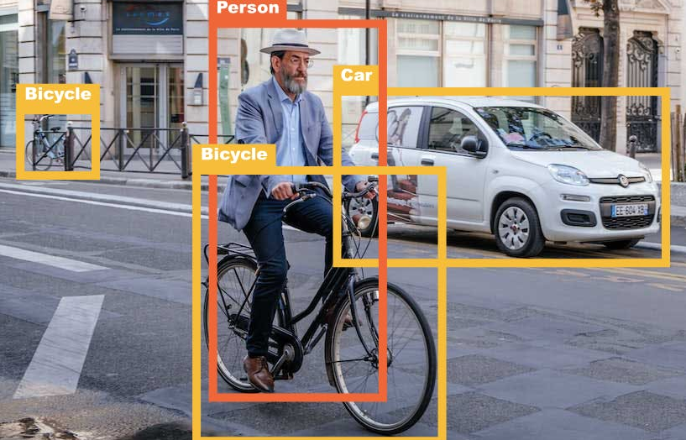

Machine Learning

Slide 13






Supervised learning
Using the model
Training
Data
Model
Output
Truth value
Layer 1
Layer 2
After seeing a lot of data with truth values – model can be used on unkown data with high accuracy!
Bird
Node
Node
Car
Flower
Bird
Bird
Bus
Node
This is basically how most machine learning models are obtained
Flower
Node
Node
Deep learning = More layers.
Mathematical operations

Slide 14
ML for time series
Works the same way!
Layer 1
Layer 2
3
5
4
10
6
3
5
2
Node
Output
Truth values
Error
3
5
4
10
6
3
5
2
Node
Node
5
4
8
5
3
8
0
-1
0
=
Node
Node
Node
5
3
8
Node
Truth values we want to predict
When trained enough the model can be used to predict unknown values

Slide 15
3. Method

Slide 16

Deep learning in EPF (Electricity price forecasting)
14 reviewed papers
Deep neural networks outperform other models, both machine learning and statistical models
The best performing model of the papers was usually LSTM, CNN and MLP or a hybrid of these

Slide 17
Short about the models
MLP
= Multi-layer perceptron
LSTM
= Long Short-Term Memory
CNN
= Convolutional Neural Network
Feed-forward
Output obtained by weight matrix multiplication put through activation function
FÖRENKLA!!!
Loops in connections
Node have 3 gates that perform operations to learn long-term dependencies
Convolution with help of weight kernel that capture features of data
Pooling reduces dimensions while summarizing features

Slide 18

Method & Hypothesis
Method:
Gather relevant data
Build an LSTM, a CNN and an MLP
Evaluate them against each other and a benchmark model (ARIMA)
Fulfills objective

Slide 19



Nord Pool data
Nord Pool data
For each price area
Consumption
Consumption prognosis one day ahead
Production
Production prognosis for one day ahead
Wind power production prognosis
Hydro reservoir levels in Sweden

Slide 20



SMHI data
SMHI weather data
For each price area, average of
Air pressure
Air temperature
Wind speed
Relative humidity
Cloud cover

Slide 21

Calendar data
Calendar variables
Month integer (1-12)
Weekday integer (1-7)

Slide 22
Complete data set
Nord Pool data
For each price area
Consumption
Consumption prognosis one day ahead
Production
Production prognosis for one day ahead
Wind power production prognosis
Hydro reservoir levels in Sweden
SMHI weather data
For each price area, average of
Air pressure
Air temperature
Wind speed
Relative humidity
Cloud cover
Calendar variables
Month integer (1-12)
Weekday integer (1-7)

Slide 23
Data preprocessing
Min-max normalization of all data to [0,1]
Sequencing
70 % 15 % 15 % training, validation and test set split

Slide 24
4. Results

Slide 25
Grid search obtained models
MLP
LSTM
CNN

Slide 26
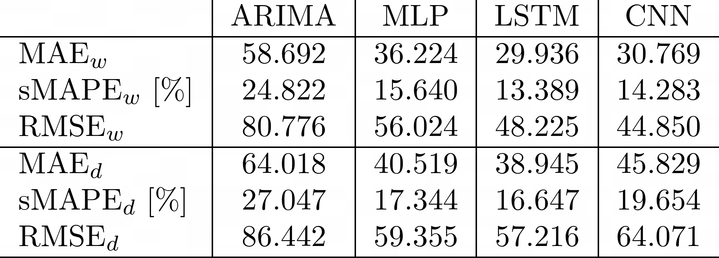
Evaluation metrics
Mean Absolute Error (MAE)
Root Mean Square Error (RMSE)
symmetric Mean Absolute Percentage Error (sMAPE).
Statistical model for comparison
Results

Slide 27
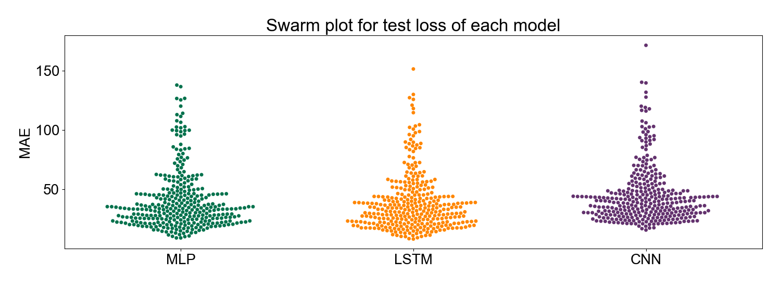
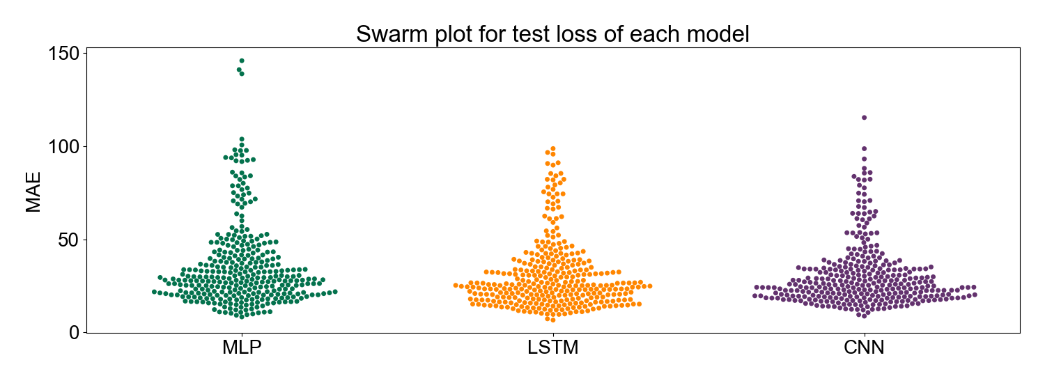
Resulting errors
Daily sequencing
Weekly sequencing

Slide 28
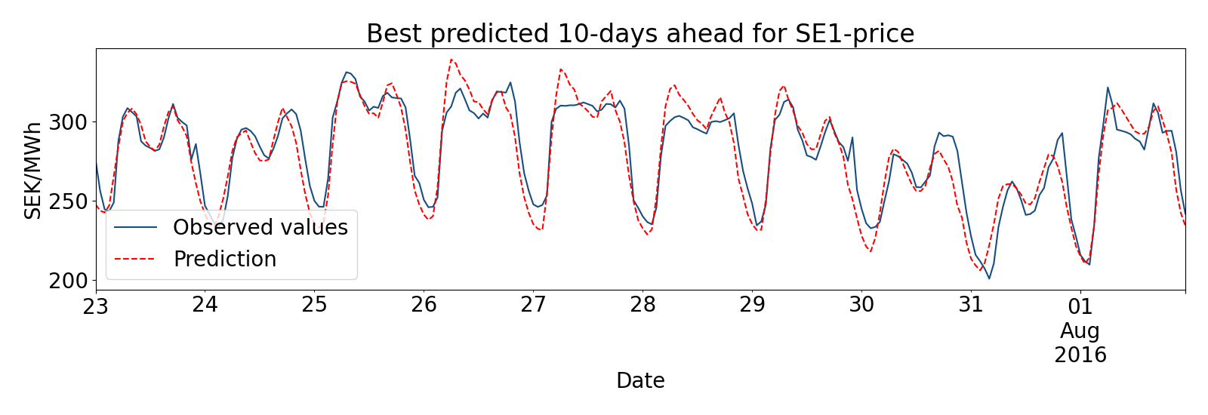
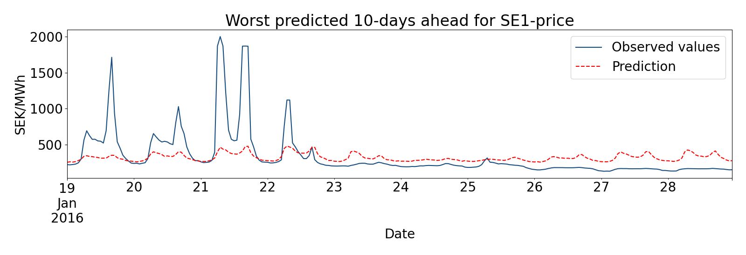
Resulting predictions MLP
(Weekly sequencing)
MAE = 8.369
MAE = 146.025

Slide 29
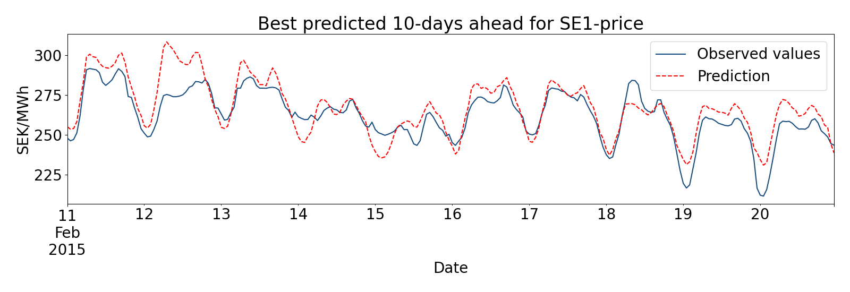
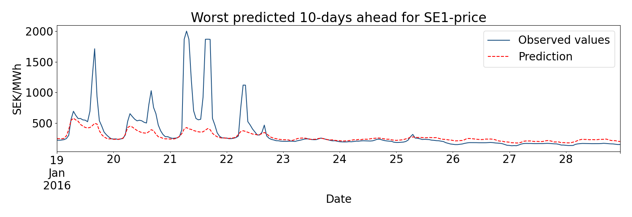
Resulting predictions LSTM
(Weekly sequencing)
MAE = 7.757
MAE = 116.508

Slide 30
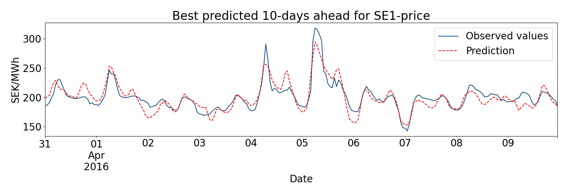

Resulting predictions CNN
(Weekly sequencing)
MAE = 8.788
MAE = 115.449

Slide 31
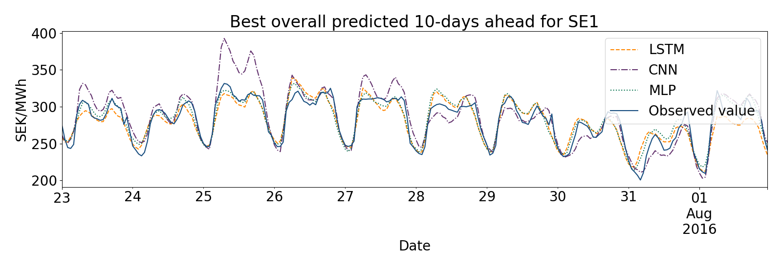
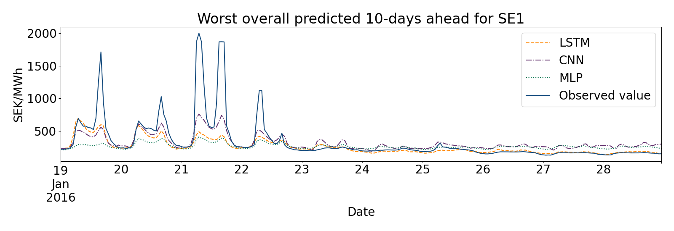
Comparison best and worst predictions

Slide 32
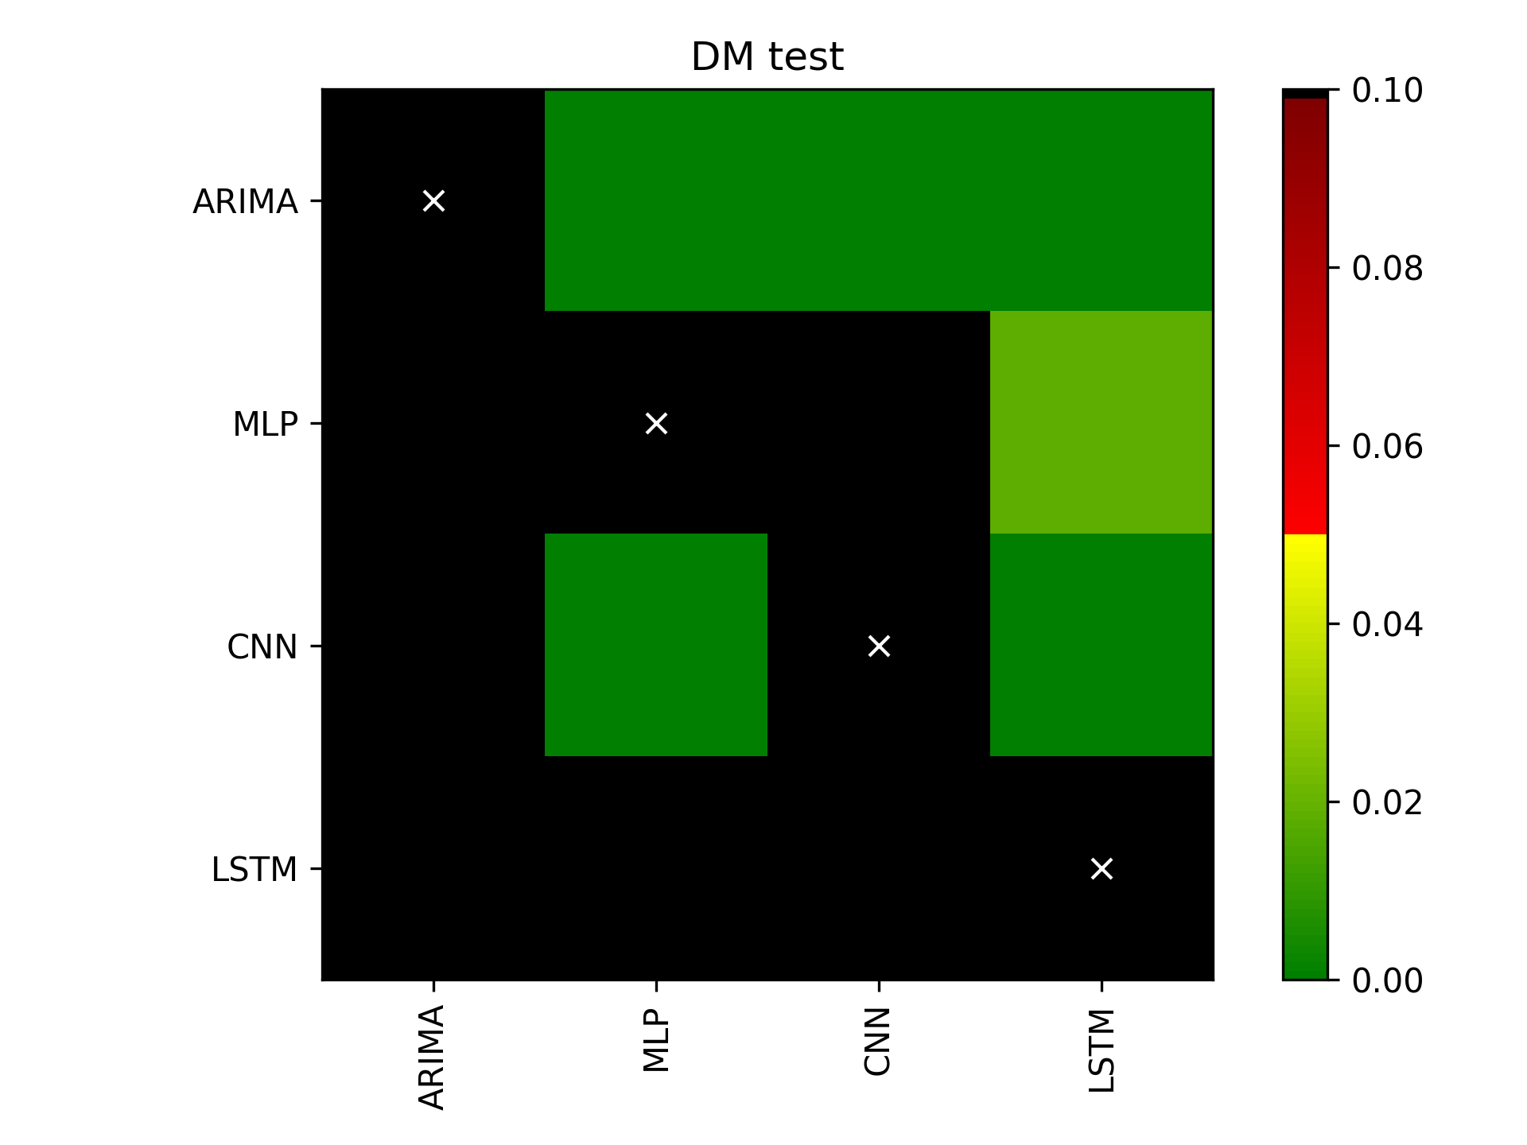
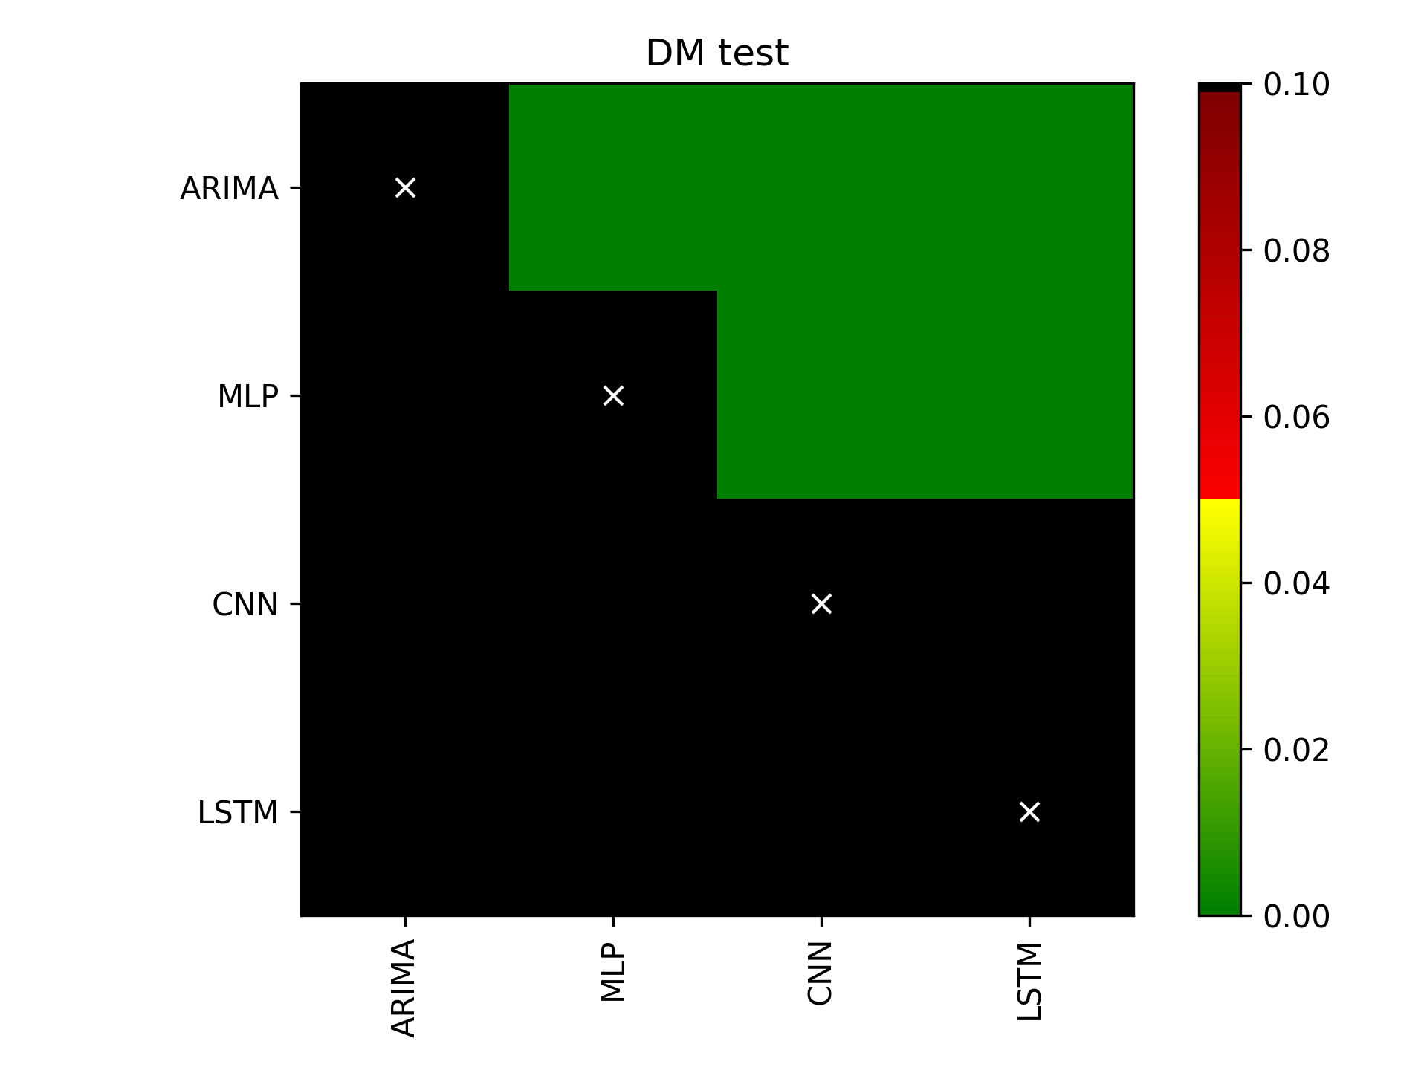
Diebold-Mariano test
Daily sequencing
Weekly sequencing
LSTM better than all others
LSTM and CNN better than all others

Slide 33
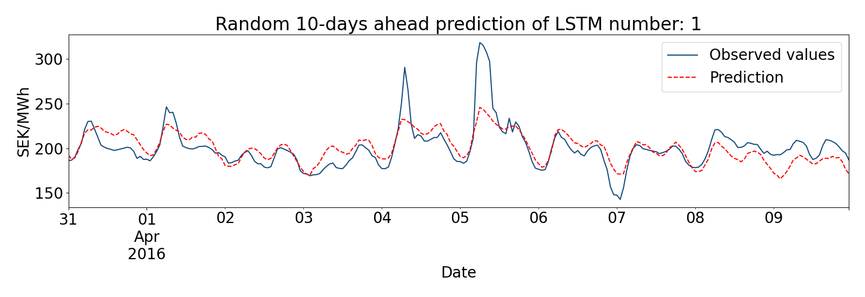
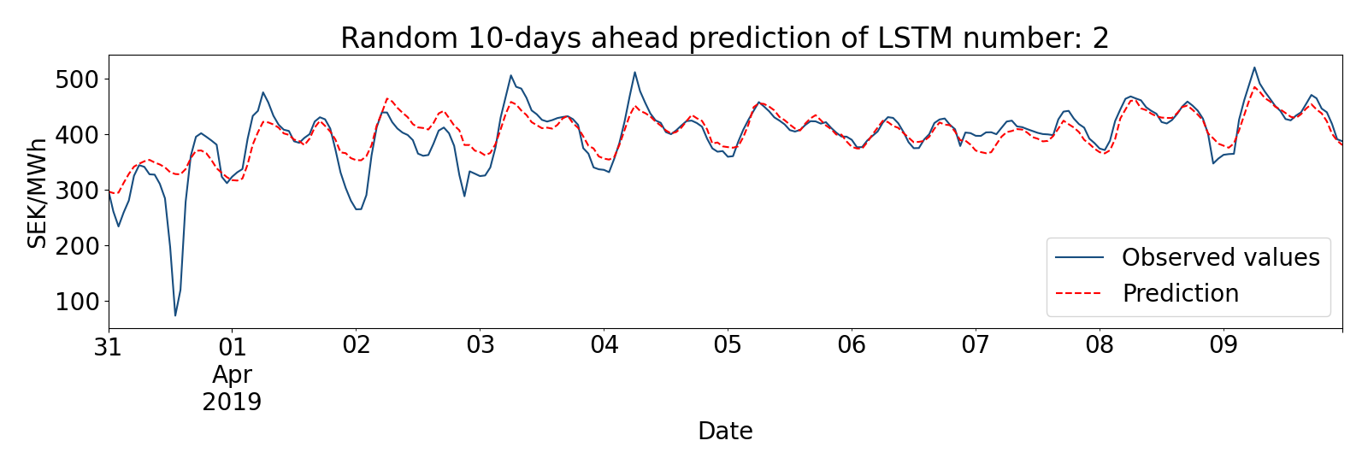
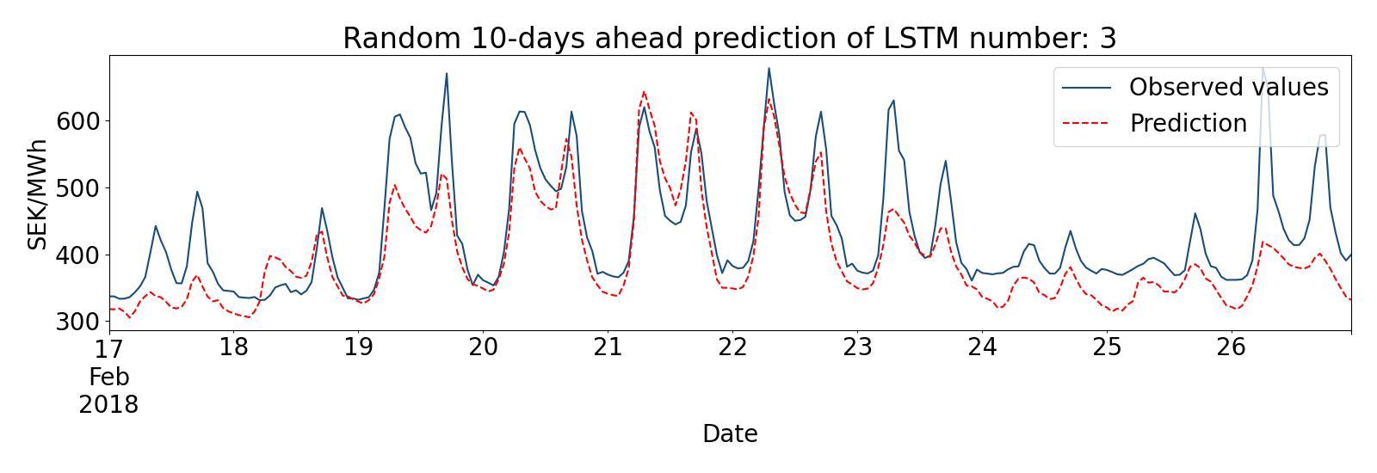
Randomly selected predictions LSTM

Slide 34
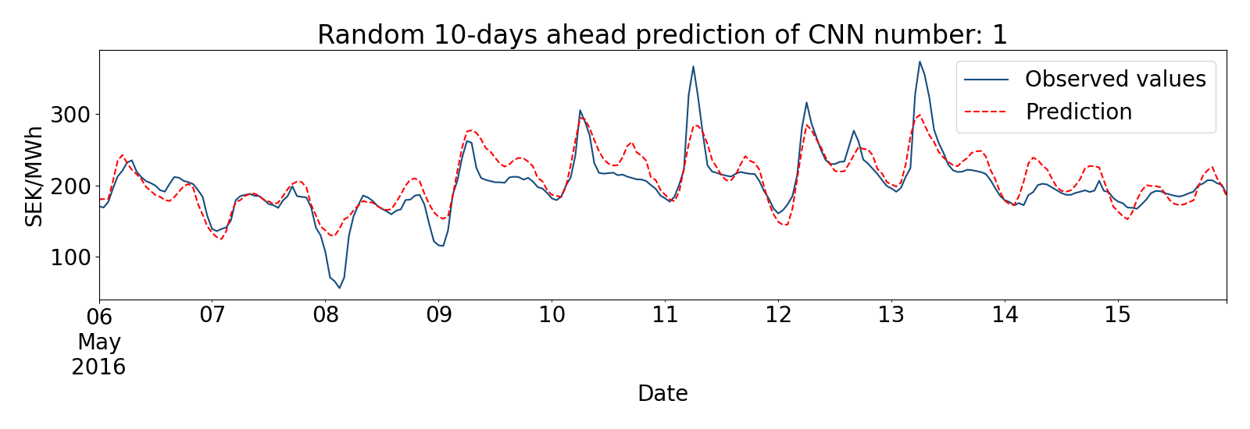
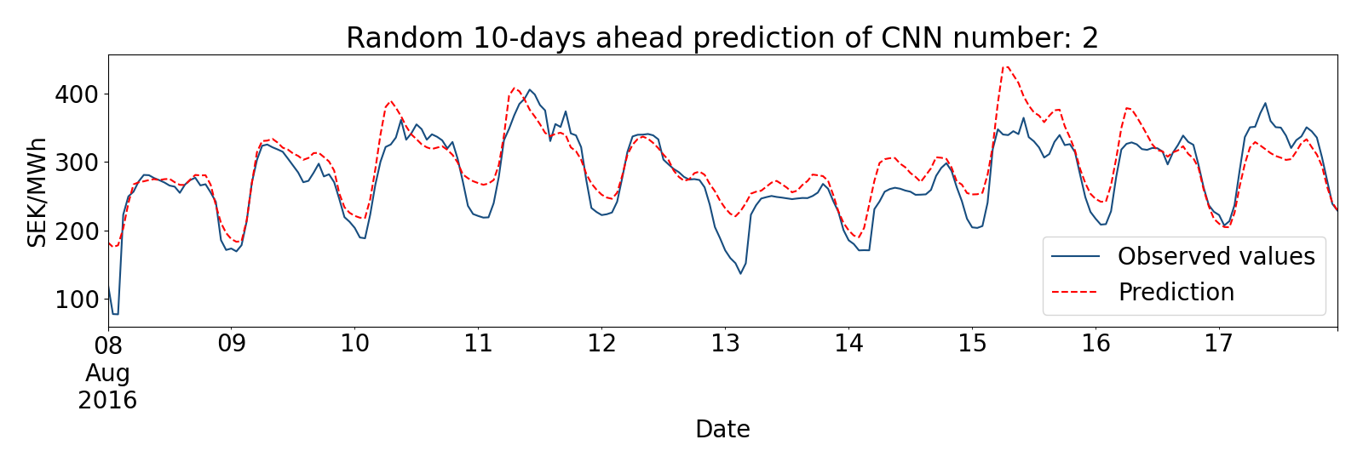
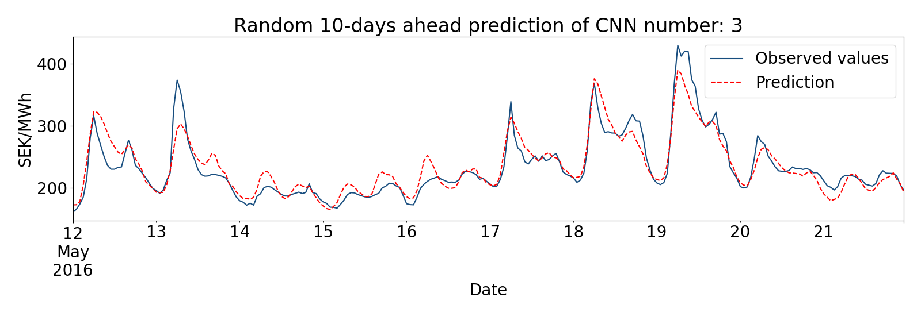
Randomly selected predictions CNN

Slide 35
5. Conclusions

Slide 36

Conclusions
Rather simple deep learning models can predict prices with high accuracy, except for the most extreme sudden peaks.
Using weekly sequencing yields higher accuracy
All the deep networks outperformed the benchmark statistical model. In particular, LSTM and CNN with weekly sequencing performed best.

Slide 37


Thank you!

